Slide 1
MERKLE TREES

Slide 2
MERKLE TREES
Implemented based on Binary Trees.
Hash the data and then stores the data hash in the leaf nodes only.
Each node has up to 2 children.
Space efficient as it stores hashes instead of full content of the files.
Uses for data verification in distributed systems: P2P networks, Bitcoin, Git.
Bitcoin uses it as a digital fingerprint of the entire set of transactions.

Slide 3
MERKLE TREE
To store transactions: A, B, and C.
H_{A} = SHA256(SHA256(Transaction A))
H_{B} = SHA256(SHA256(Transaction B))
H_{AB} = SHA256(SHA256(H_{A} + H_{B}))
The process continues until there is only one node at the top, the node known as the merkle root.
If there is an odd number of transactions, the last transaction hash will be duplicated to create an even number of leaf nodes.
H_{CC} = SHA256(SHA256(H_{C} + H_{C}))

Slide 4
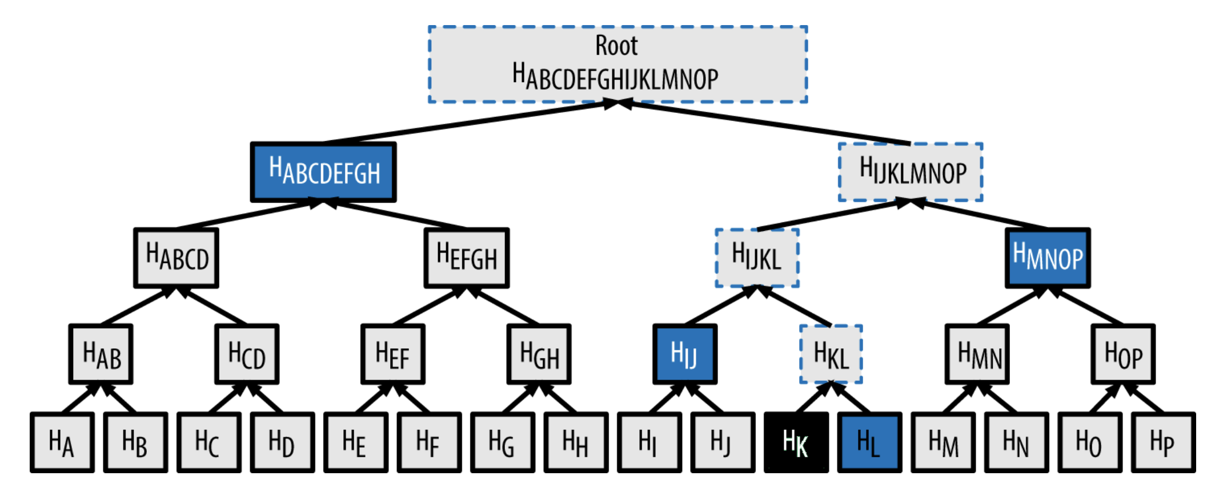
FINDING A TRANSACTION (K) IN A MERKLE TREE

